Slide 1

Struktur Data
Searching
Prepared by
Frans Panduwinata, S.Kom, M.T

Slide 2

Overview
Searching refers to finding out whether a particular element is present in the list.
The method that we use for this depends on how the elements of the list are organized.
  If the list is an unordered list, then we use linear or sequential search, whereas
  if the list is an ordered list, then we use binary search.

Slide 3
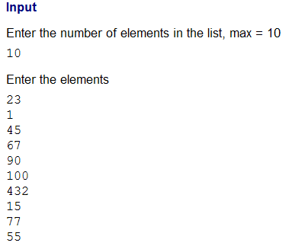
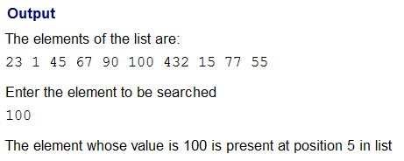
Example
EXAMPLE:

Slide 4
Exercise
Write a program with output:
Press r to generate 4 random numbers between 1 to 9
unidentically. (Rules: “2A” means there is 2 right
numbers in the right place, “1B” means there is 1
right number but in the wrong place).
First guess: 1234
1A
Second guess: 3598
3B
Third guess: 7935
4A
You win!!!

Slide 5
Exercise (cont)
Use the function time() to initialize the random number
generator:
#include <time.h> // Prototype of time()
#include <stdlib.h> // Prototypes of srand() and // rand()
long sec;
time( &sec ); // Take the number of seconds and
srand( (unsigned)sec ); // use it to initialize.
(rand() % 100 + 1) // Random number between 1 and 100

